Slide 1

Change Management Principles for CRM Software Conversion
Presented by Kimberly Perron, MBA
Customer Success Instructor

Slide 2










Slide 3
POLL – Why strategic planning?
Why does your organization want to undertake strategic planning?
Our team needs to get on the same page
We’ve been reacting to changes to frequently
We are not making sufficient progress towards our vision
We’d like to be able to share a strategic plan with donors
So that we don’t keep changing the target each year
Other reason

Slide 4
STRATEGIC PLANNING – Benefits
Team alignment
Proactive instead of reactive
Desire to improve/achieve vision
Makes annual planning easier
Strengthens communications
Focuses attention

Slide 5
STRATEGY – Overall Direction
Long-term view 3 – 5 years
Incorporates vision, mission, and values
Examines internal and external factors
Attempts to determine “why”
Creates major objectives to help achieve vision

Slide 6
STRATEGY – DIY or Consultant
Experience of leadership
Complexity of issues
Availability of project manager
Cohesiveness of team
Financial and time considerations
Outside perspective

Slide 7
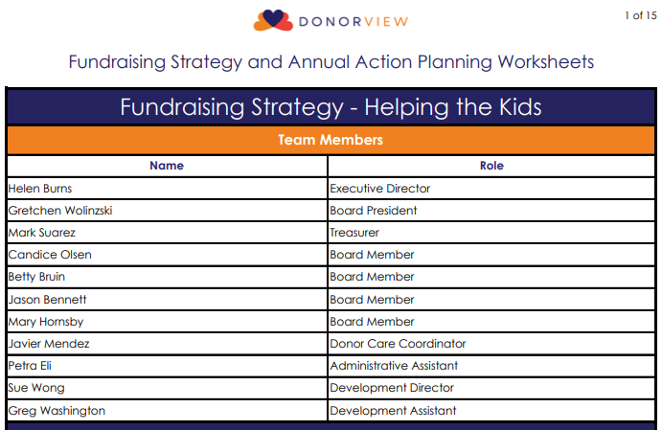
STRATEGY – Team Members
Executive team
Fundraising team
Board of Directors
Other key stakeholders

Slide 8
STRATEGY – Guiding Principles
Foundation for strategy and plans
Helps with decisions
Clarity of purpose
VISION
MISSION
VALUES

Slide 9
POLL – Ranking
Rank the guiding principles in order of importance:
#1- Vision, #2 - Mission, #3 - Values
#1- Mission, #2 - Values, #3 – Vision
#1- Values, #2 - Vision, #3 – Mission
They are equally important
VISION
MISSION
VALUES

Slide 10
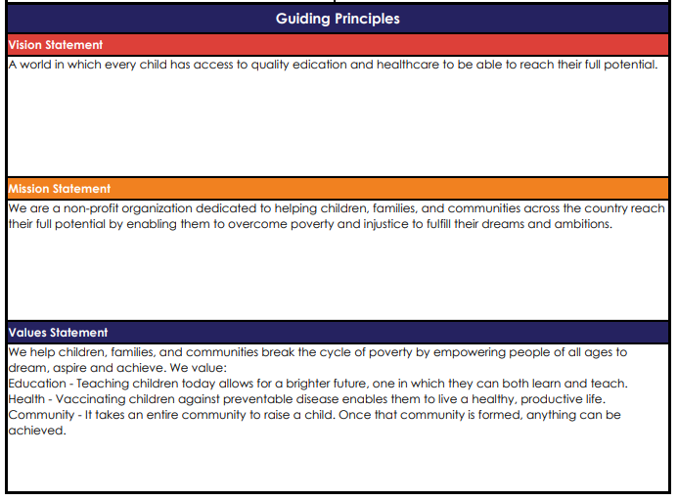
STRATEGY – Guiding Principles
Vision
Mission
Values

Slide 11
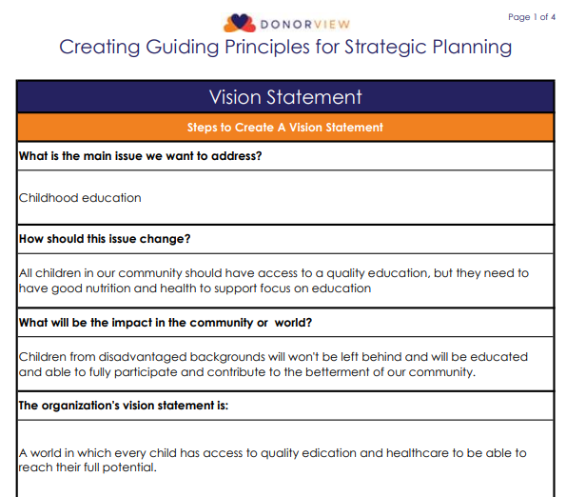
Guiding Principles – Vision
Main Issue
Desired Change
Impact
Formulate vision

Slide 12
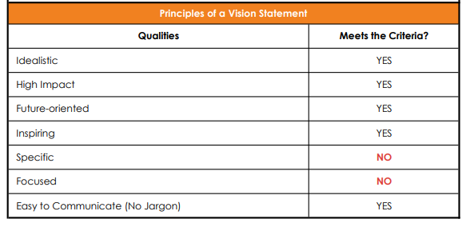
Guiding Principles – Vision

Slide 13
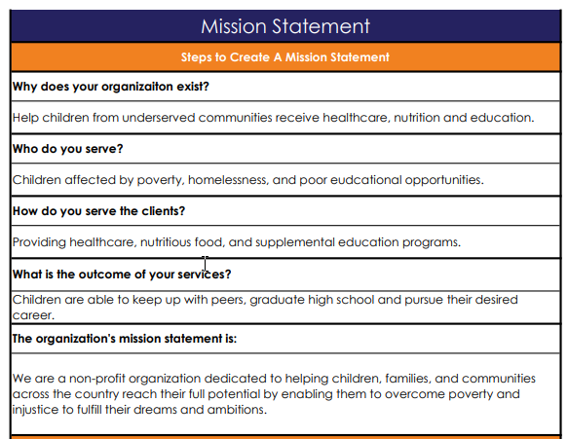
Guiding Principles – Mission
Why?
Who?
How?
Outcomes?

Slide 14
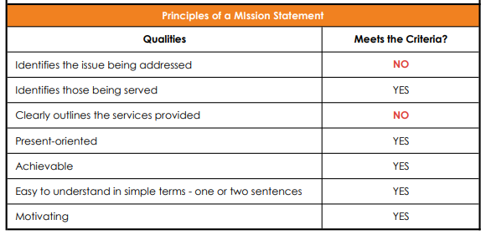
Guiding Principles – Mission

Slide 15
POLL – Values
What value would you like your organization to embody?
Creativity
Trustworthiness
Caring
Knowledgeable
Diversity
Spirituality
Environmentally Conscious
Bold
Efficient
Optimistic

Slide 16
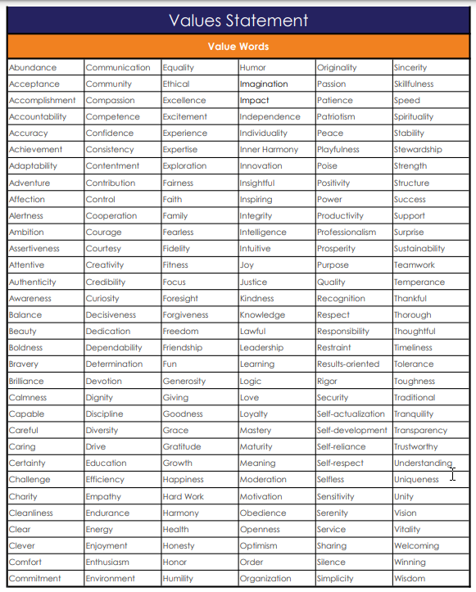
Guiding Principles – Values

Slide 17
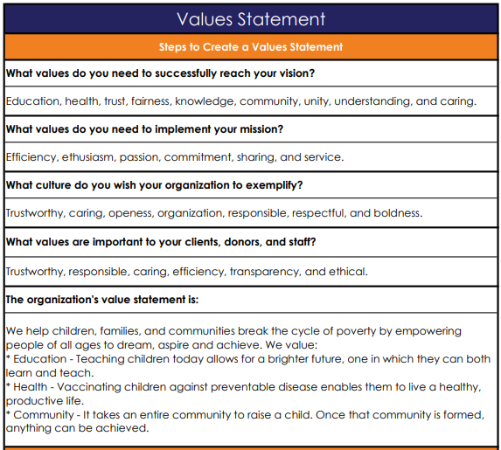
Guiding Principles – Values
Vision
Mission
Organization
Stakeholders

Slide 18
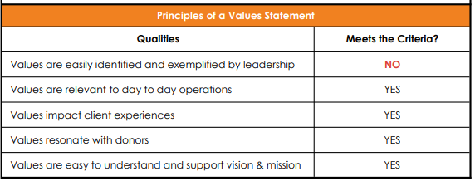
Guiding Principles – Values

Slide 19
Issues – Obtaining Input
Staff
Donors
Clients
Board members
Executive team
General public

Slide 20
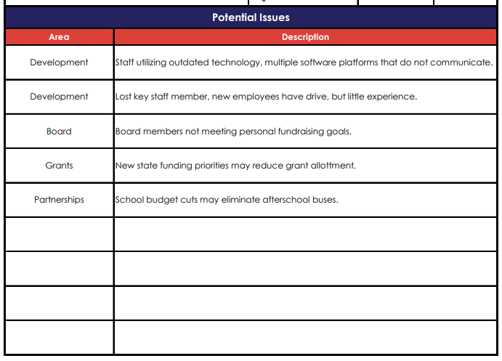
POTENTIAL ISSUES – From Feedback
Can identify known issues
Focused on fundraising, but may reveal other issues
Be sure to include in SWOT Analysis

Slide 21
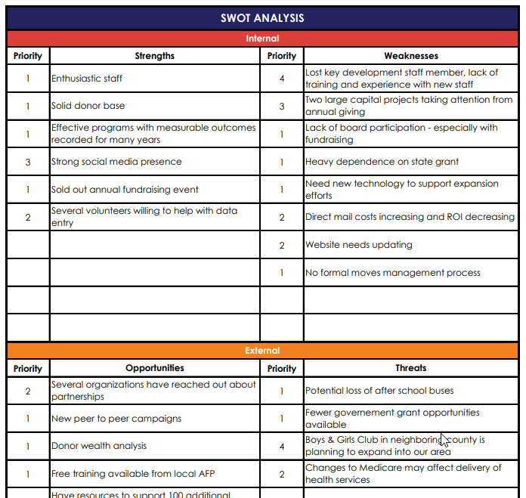
SWOT ANALYSIS
Internal
Strengths
Weaknesses
External
Opportunities
Threats

Slide 22
SWOT ANALYSIS
Describe issue
Deep dive into reasons
Root cause - 5 Whys?
Adds clarity
Ideas to address issues
Evaluation - Scoring system

Slide 23
SWOT ANALYSIS - Evaluate
Ease:
How simple or easy is it to address this issue – easier, higher score
Cost:
The cost to address the issue – lower cost, higher score
Impact:
The impact on the organization or fundraising efforts if this issue is addressed – bigger the impact, higher the score
Alignment:
Does this issue positively affect our ability to embody our values, accomplish our mission, or achieve our vision – more alignment, higher score
Numbers are subjective, based on opinions of those participating
Higher total score = better expected outcome

Slide 24
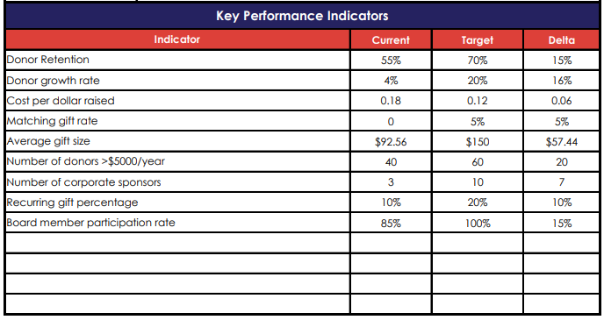
KPIs – Key Performance Indicators
Snapshot (lagging)
Direction - % or time comparison (leading)
What are industry averages

Slide 25
SWOT – Strengths
Review your fundraising processes
Workflows
Good KPIs
What are you doing well
Extra resources
Skills & experience

Slide 26
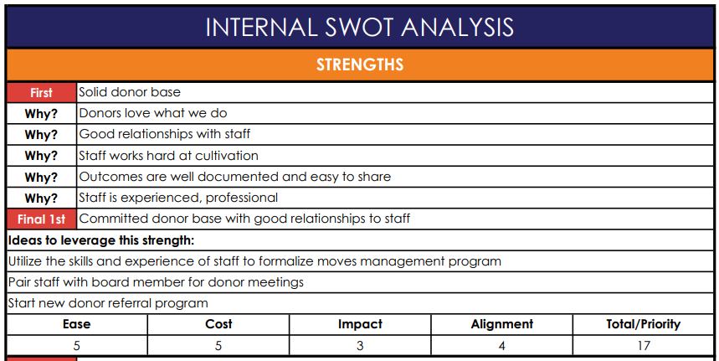
SWOT – Strengths

Slide 27
SWOT – Weaknesses
Identified internal issues from feedback
Poor Workflows
Unsatisfactory KPIs
Lack of technology/resources
Training
Staffing

Slide 28
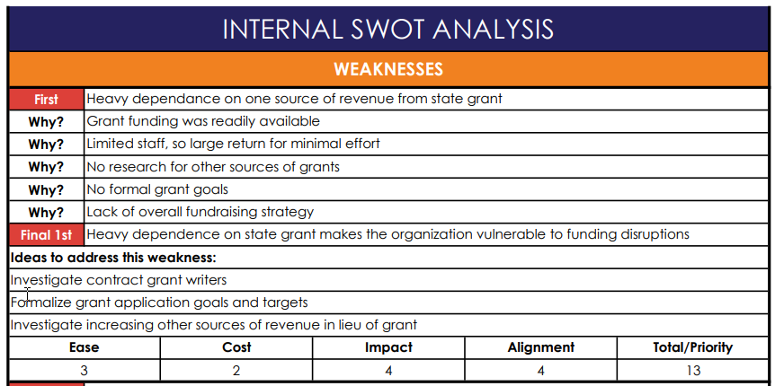
SWOT – Weaknesses

Slide 29
SWOT – Opportunities
Trends
Funding sources
Partnerships
Technology
Prospect research
Services

Slide 30
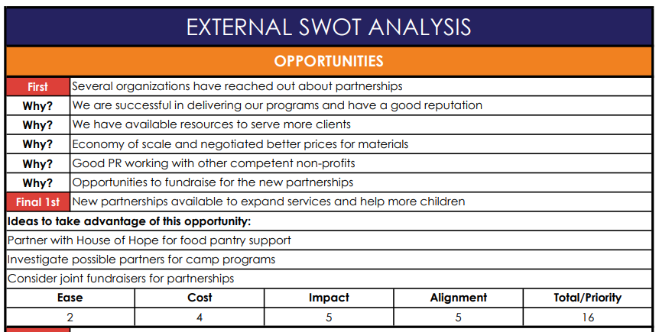
SWOT – Opportunities

Slide 31
POLL – Threats
What is the biggest threat facing your organization right now?
Competition (other non-profits or for-profits)
Negative trends – politics
Negative trends - economy
Natural disasters
New government regulations
Donor/volunteer loss

Slide 32
SWOT – Threats
Competition
Negative trends – politics/economy
Natural disasters
Government regulations
Donor/volunteer loss
Other vulnerabilities

Slide 33
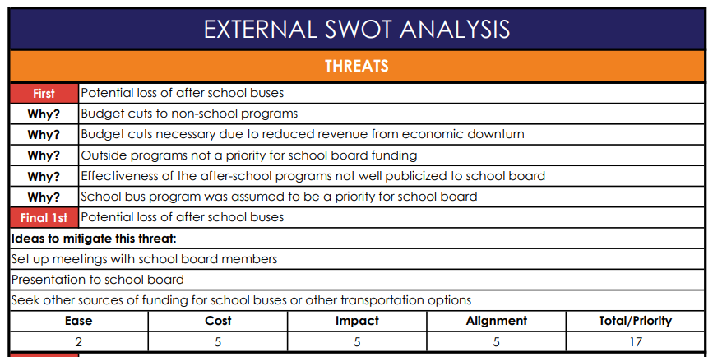
SWOT – Threats

Slide 34
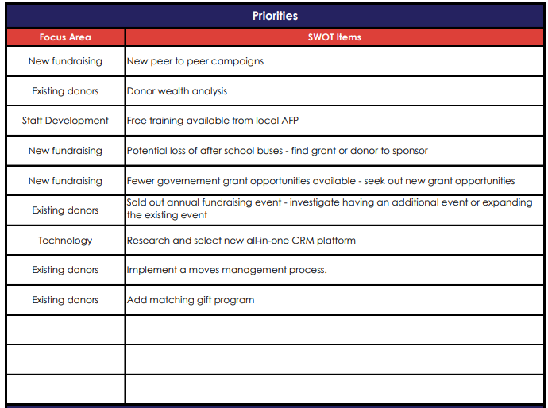
SWOT – Prioritize
Prioritize issues
Get stakeholder’s
input
Validate with guiding principles

Slide 35
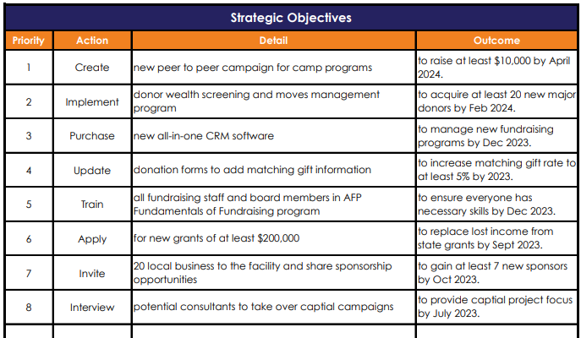
STRATEGIC OBJECTIVES
Create an objective for each priority/KPI
Multiple objectives For one complex SWOT issue
Verb + Activity + Measurable Outcome
Feeds Action Plan

Slide 36
STRATEGIC OBJECTIVES - Evaluate
Financial Impact:
Revenue generation or cost avoidance
Operations Impact:
More efficient activities or better delivery of service
Personnel Impact:
Improves culture, communication, or leadership and staff skills
Social Impact:
Improves ability to serve clients – directly moving closer to vision
Risk:
Level of effort, scope, criticality of activities affected, or potential for unexpected outcome

Slide 37
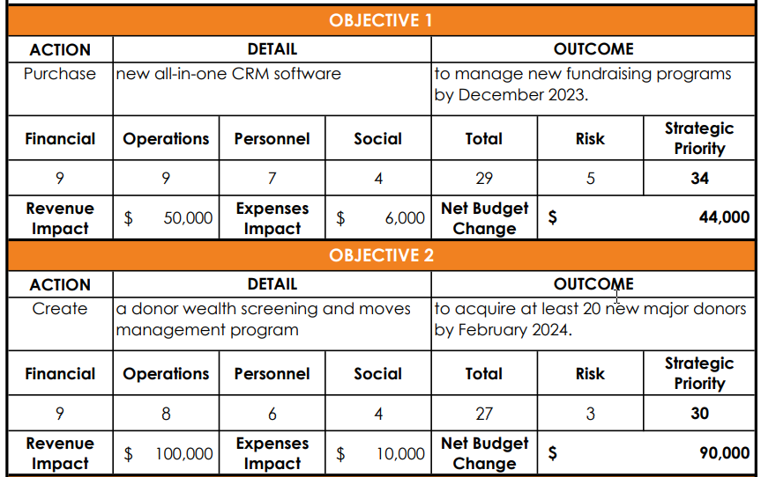
STRATEGIC OBJECTIVES - Score

Slide 38
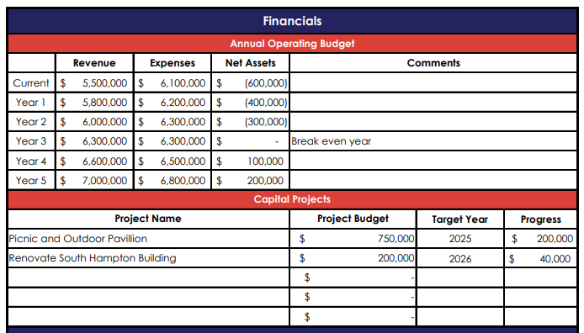
STRATEGY – Financial Situation
Operating Budget
Capital Projects
Complete after SWOT & priorities

Slide 39
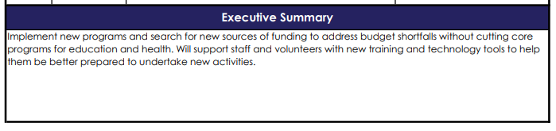
STRATEGY – Executive Summary
Summarize overall direction
One or two sentences
Be specific

Slide 40
Watch the video and download the free Excel worksheet Donorview.com/AFPwebinar Register at AFP Global for next webinar on August 17th Annual Fundraising Plan - Deep Dive
Next Steps

Slide 41
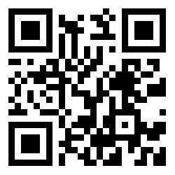
THANK YOU!
Request a Demo
Scan to visit our website and set up a free demo!
DonorView.com/Demo
Contact Us:
508-205-0243
sales@donorview.com
donorview.com

